Slide 1
15 Puzzle game
By Team 6

Slide 2
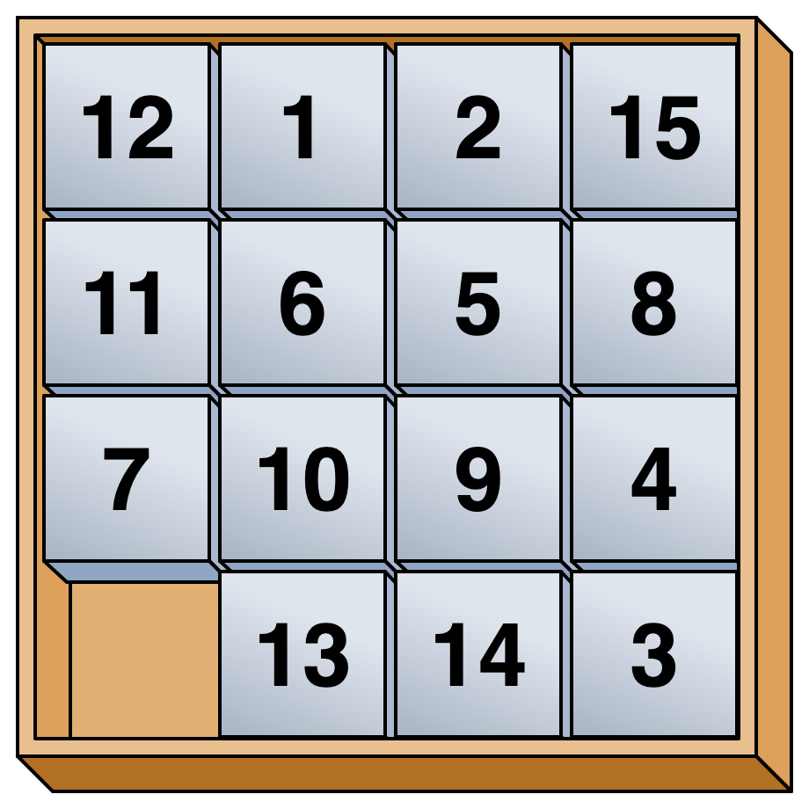
Remember this game?

Slide 3
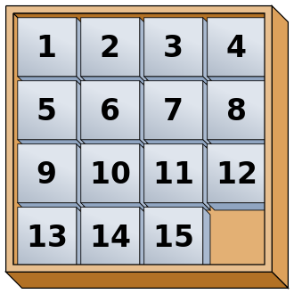
We solved it!!

Slide 4
Let’s do this in Python!

Slide 5
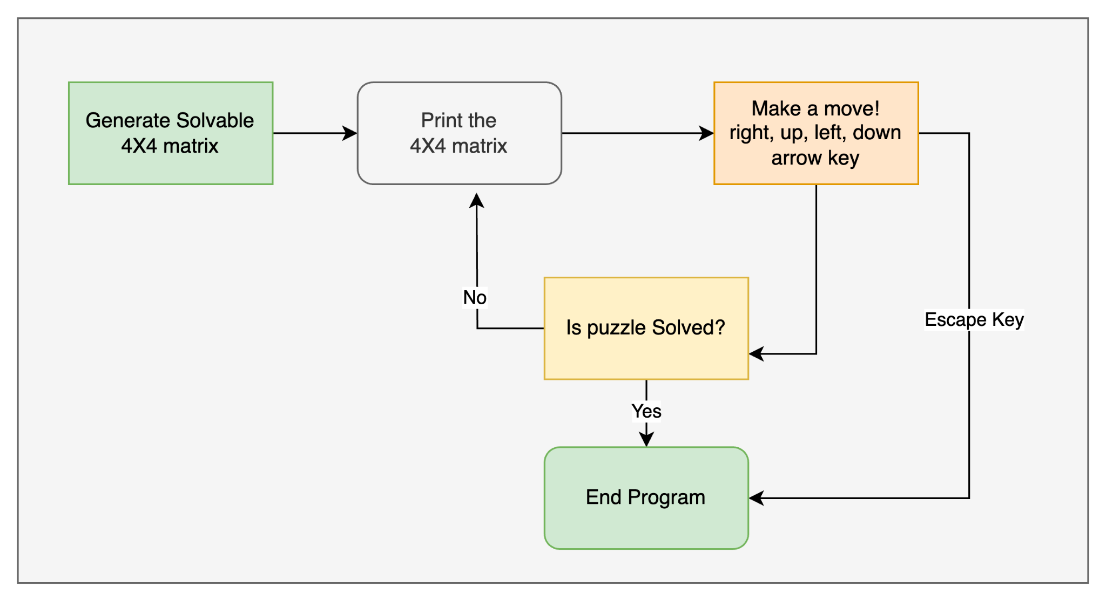
Flowchart

Slide 6
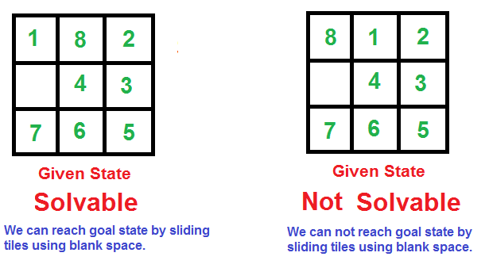
Generating Solvable Matrices
Notes:
The 8-puzzle is solvable if the sequence of numbers has an even number of inversions

Slide 7
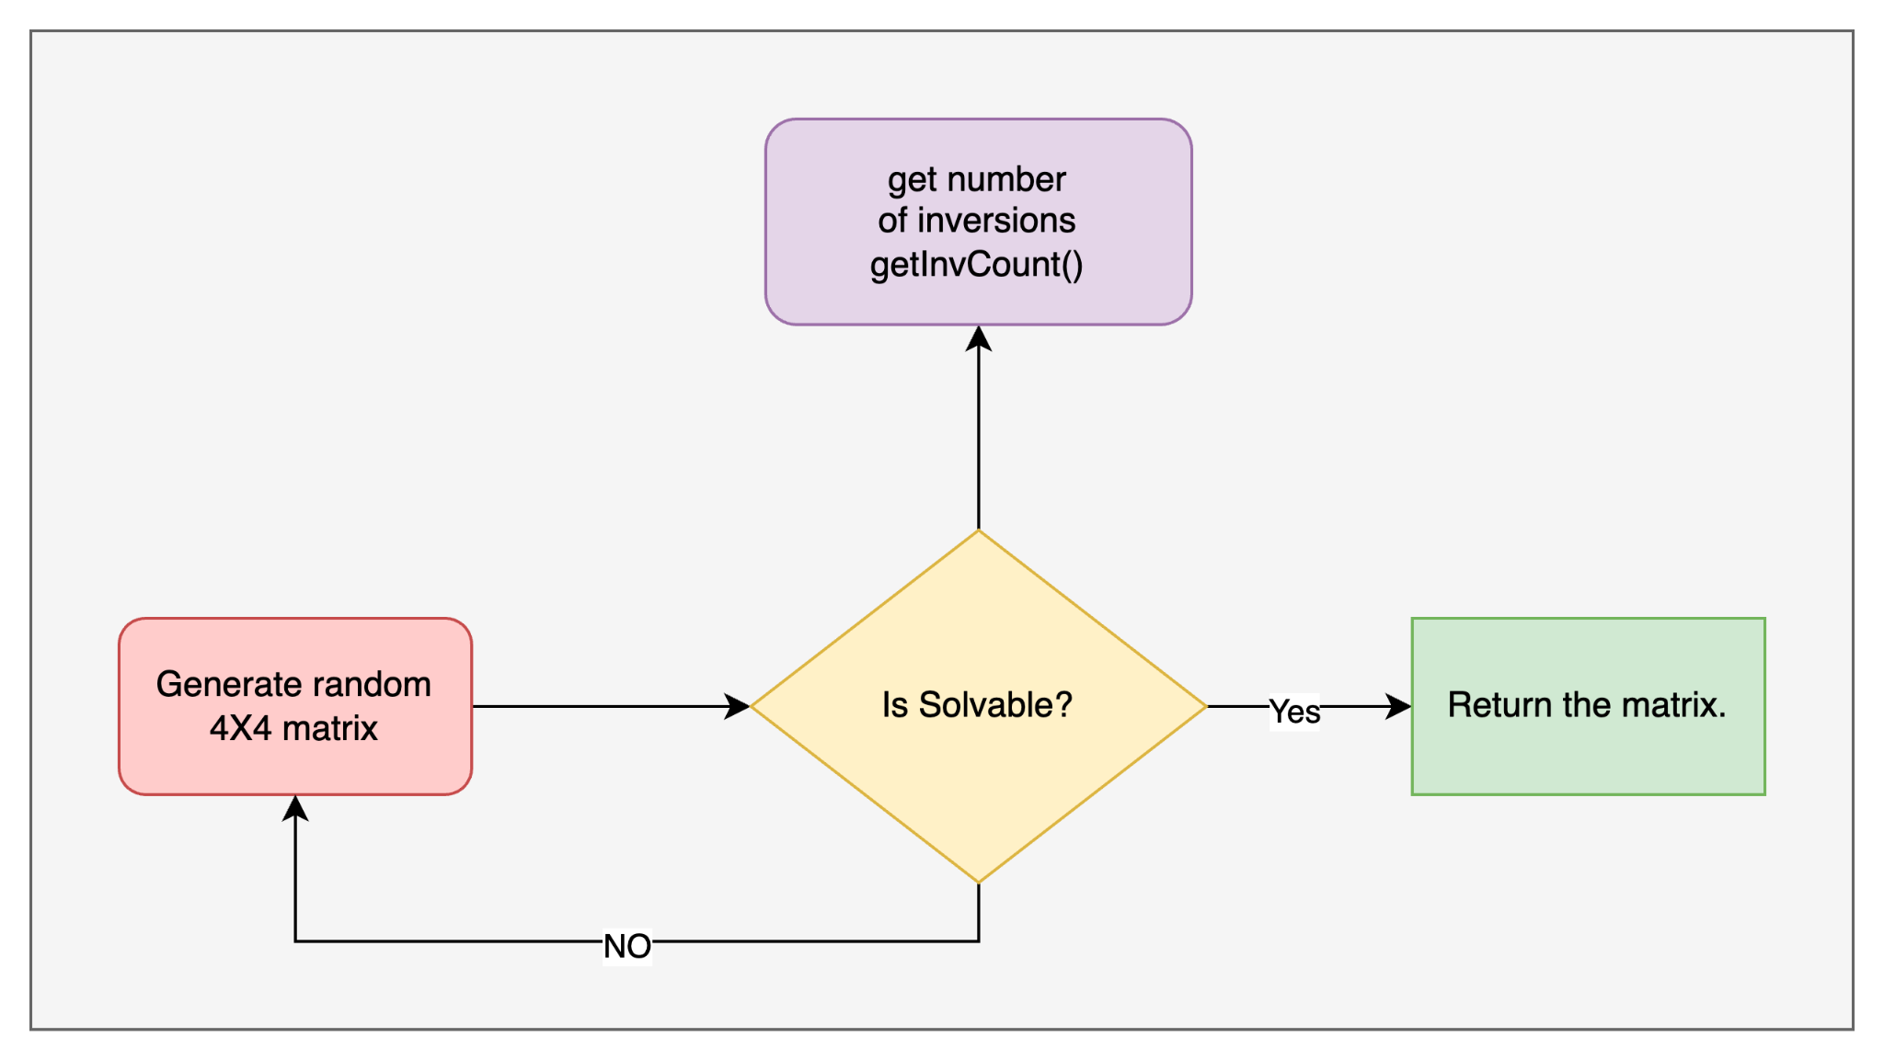
Function for Generating Solvable Matrix
getInvCount() function to calculate the number of inversions in the flattened array.
The isSolvable function returns True if the number of inversions is even, indicating a solvable puzzle.
The getInvCount() function iterates through all pairs of elements in the array.
It increments the inversion count when a pair of numbers is in the wrong order, indicating an inversion.

Slide 8
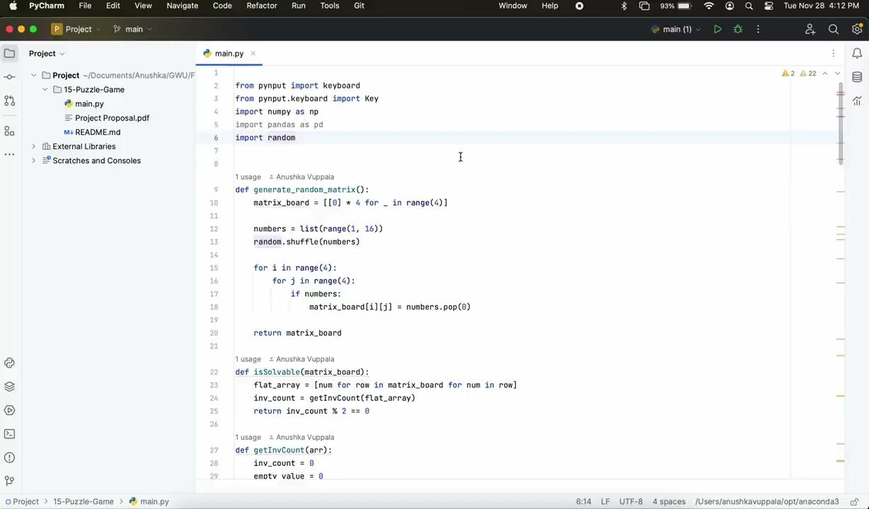
Demo

Slide 9
THANK YOU

